Slide 1
Integrated Wildfire Risk Prediction and Monitoring System Using Multi-Source Data and Advanced Machine Learning Techniques

Slide 2
Introduction
This project focuses on developing a comprehensive wildfire risk prediction and monitoring system by integrating diverse data sources and utilizing advanced machine learning techniques. By collecting fire data from NASA FIRMS, weather data from Meteostat, satellite imagery from USGS, and human activity data from OpenStreetMap, the system establishes a unified data lake for robust feature engineering.

Slide 3
Related work
 | Title | Authors | Description
1. | Global Wildfire Danger Predictions Based on Deep Learning Taking into Account Static and Dynamic Variables | Yuheng Ji, Dan Wang, Taihui Liu, Yu Bai | This paper emphasizes on the impact of climate change on wildfires. They combine data from static and dynamic positional variables. They propose a static location-aware ConvLSTM model to discern the influence of dynamic variables across various geographical locations on predictive outcomes.
2. | FireCast: Leveraging Deep Learning to Predict Wildfire Spread | David Radke, Anna Hessler, Dan Ellsworth | This paper aims to reduce the computational costs associated with mathematical and physics-based prediction approaches by proposing a novel system that combines AI and data collection strategies from geographical information systems. It predicts which areas surrounding a burning wildfire have high-risk of near-future wildfire spread, based on historical fire data.

Slide 4
Related work
 | Title | Authors | Description
3. | Generative Algorithms for Fusion of Physics-Based Wildfire Spread Models with Satellite Data for Initializing Wildfire Forecasts | Bryan Shaddy, Deep Ray, Angel Farguell, Valentina Calaza, Jan Mandel, James Haley, Kyle Hilburn, Derek V. Mallia, Adam Kochanski, and Assad Oberai | This paper is aimed at finding the fire arrival time at a particular location using atmosphere and wildfire models by data assimilation. They try to generate a list of possible arrival times using cWGAN network and then take the mean value of it which is fed into atmosphere-wildfire model.
4. | Forest Fire prediction using Machine Learning Methods | Ferdaous Abdessemed, Souheila Bouam, Chafik Arar | The paper is a comparison study between machine learning models such as KNN, Decision tree, Random Forest and SVM for forest fire prediction. They claim to have an accuracy of 97.95% for Decision tree model with three attributes such as relative Humidity, wind speed and temperature.

Slide 5
Related work
 | Title | Authors | Description
5. | A Novel Approach for Predicting Large Wildfires Using Machine Learning | Nikita Agrawal Peder V. Nelson and Russanne D. Low | This paper presents a machine learning model to predict large wildfires across the United States using satellite data (such as NDVI, EVI, and LST) and atmospheric reanalysis data. The study applies six machine learning models, with XGBoost achieving the highest accuracy (90.44%) for predicting wildfire occurrence.
6. | Deep Learning Models for Predicting Wildfires from Historical Remote-Sensing Data | Fantine Huot, R. Lily Hu, Matthias Ihme, Qing Wang, John Burge, Tianjian Lu, Jason Hickey, Yi-Fan Chen, John Anderson | This paper explores the use of deep learning techniques, specifically convolutional autoencoders and U-Nets with LSTM, to predict wildfire occurrences from historical satellite data. The research focuses on image segmentation to differentiate between fire and non-fire areas.

Slide 6
Related work
 | Title | Authors | Description
7. | A multi-modal wildfire prediction and early-warning system based on a novel machine learning framework | Rohan T. Bhowmik, Youn Soo Jung, Juan A. Aguilera, Mary Prunicki, Kari Nadeau | In this paper,a spatio-temporal ML architecture has been used to construct a multi-modal wildfire prediction and early warning system.Geological,historical wildfire data were used to form a database containing over 37 million data points
8. | Predictive modeling of wildfires: A new dataset and machine learning approach | Younes Oulad Sayad, Hajar Mousannif, Hassan Al Moatassime | The method used in this paper combines Big Data, Remote Sensing and Data Mining algorithms (Artificial Neural Network and SVM) to process data collected from satellite images over large areas and extract insights from them to predict the occurrence of wildfires and avoid such disasters.

Slide 7
DATASET - FIRMS
Provides global fire detection data within 3 hours of satellite observation, with real-time data for the US and Canada.
ATTRIBUTES
Latitude/Longitude - Numerical
Country/Region - Textual
Detection Time/Date - Date/Time
Fire Radiative Power - Numerical
Confidence level - Numerical
Detecting Instrument - Categorical
Satellite name - Categorical
Land Cover Type - Categorical
Elevation - Numerical

Slide 8
DATASET - Meteostat
Meteostat is one of the largest vendors of open weather and climate data.
They provide long term data dumps of all weather stations situated across the globe.
They also provide easy integration and usage through their APIs. We can get JSON data, use meteostate Python library to analyze the data, or you can download bulk data for historical analysis.
ATTRIBUTES
Date/Time - Temporal
Latitude/Longitude - Numeric
Temperature - Numerical - Interval Scaled
Dew Point( Moisture Content) - Numeric
Wind Direction - Numeric - Ratio Scaled
Wind Speed - Numeric - Ratio Scaled
Pressure - Numeric
Air Quality - Numeric

Slide 9
DATASET - USGS Earth Explorer
USGS Earth Explorer is an online tool by the USGS for searching, downloading, and analyzing geospatial data. Key datasets for wildfire prediction include:
Landsat: Provides multispectral imagery for monitoring vegetation health and land use.
Digital Elevation Model (DEM): Helps assess how terrain affects fire spread.
MODIS (Fire Data): Offers near real-time data for fire detection and monitoring.
ATTRIBUTES
Surface reflectance - Numeric
Thermal data - Numeric
Vegetation Indices- Numeric
Elevation - Numeric
Slope - Numeric
Aspect - Textual
Vegetation Cover - Numeric

Slide 10
DATASET - OpenStreetMap
OpenStreetMap is a collaborative project that creates a free, editable map of the world.
OSM offers several layers that can be used to analyze and understand wildfire occurrences:
Land Use: This layer categorizes land into different types such as forest, grassland, and urban areas. This information can help identify areas at higher risk of wildfires.
Natural Features: This layer includes features like rivers, lakes, and mountains. These can influence fire spread and access for firefighting resources.
Roads and Trails: his layer provides information on transportation infrastructure, which is crucial for firefighting operations and evacuations.
Buildings: This layer can help identify structures at risk and plan evacuation routes.
Elevation: This layer provides elevation data, which is important for understanding fire behavior and predicting its spread.

Slide 11
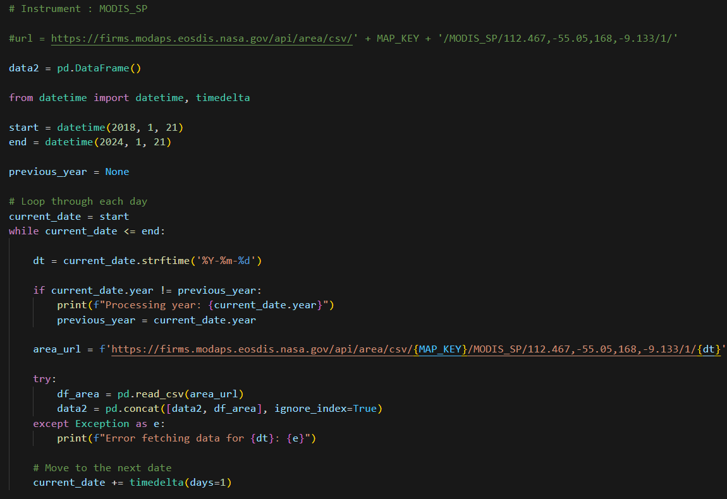
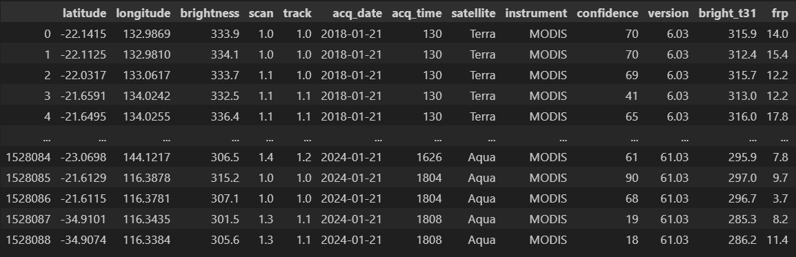
Data Collection:NASA firms data

Slide 12
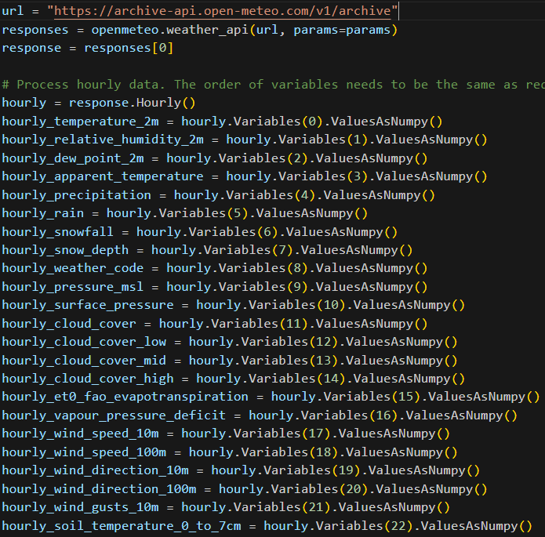
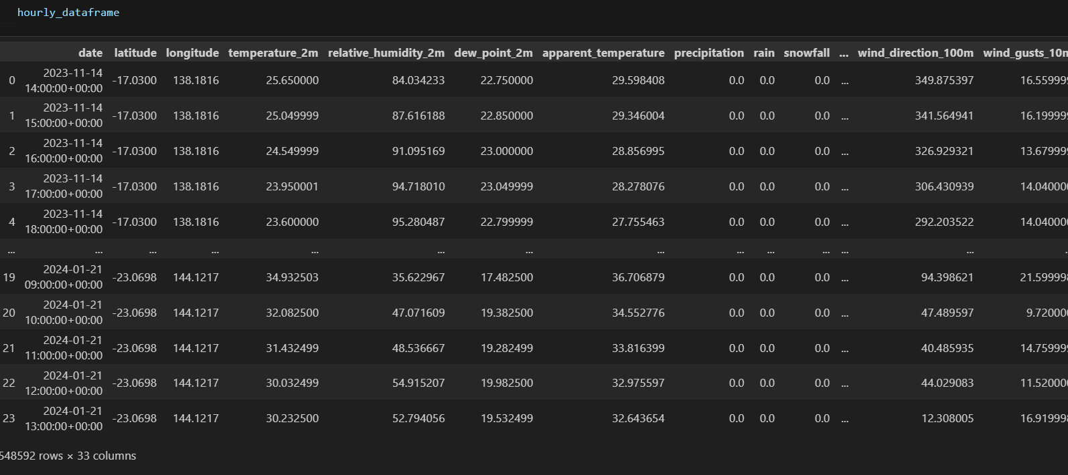
Data Collection:Open Meteo Weather API

Slide 13
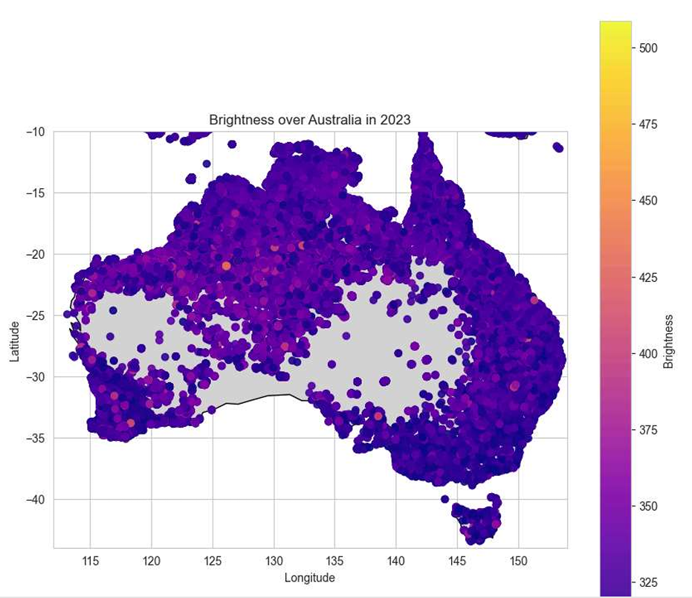
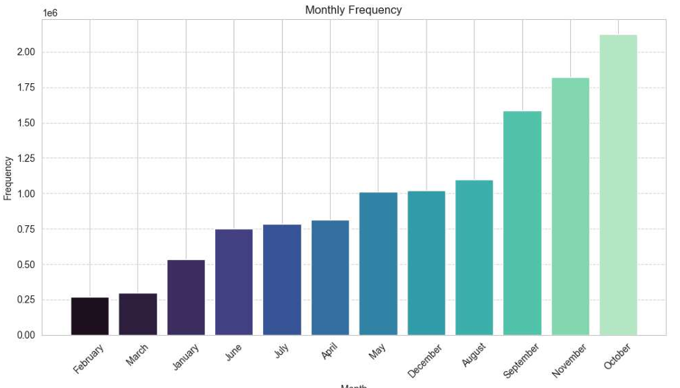
Exploratory Data Analysis

Slide 14
Proposed Work
Objectives:
Develop an integrated data pipeline for multi-source wildfire-related information
Create advanced machine learning models for wildfire risk prediction
Implement a real-time monitoring and alert system
Provide interpretable insights for fire management decision-making
Assess long-term wildfire risks under various climate change scenarios
Data Collection/Integration:
Implement APIs for NASA FIRMS, Meteostat, USGS Earth Explorer, and OpenStreetMap
Create a unified schema for merging diverse data sources
Training:
Implement and optimize Random Forest Classifier
Develop LSTM network for sequence-to-sequence prediction
Design CNN architecture for satellite imagery processing
Combine model outputs
Feature Engineering:
Calculate vegetation indices (NDVI, EVI) from satellite imagery
Generate topographical features
Develop weather-derived features, including Fire Weather Index
Create historical fire pattern features and human activity indices

Slide 15
Evaluation
Classification Metrics:
Area Under the Receiver Operating Characteristic (AUROC) curve
Area Under the Precision-Recall Curve (AUPRC)
F1 Score
Cohen's Kappa
Regression Metrics for Risk Scores:
Mean Absolute Error (MAE)
Root Mean Square Error (RMSE)
R-squared (R²)

Slide 16
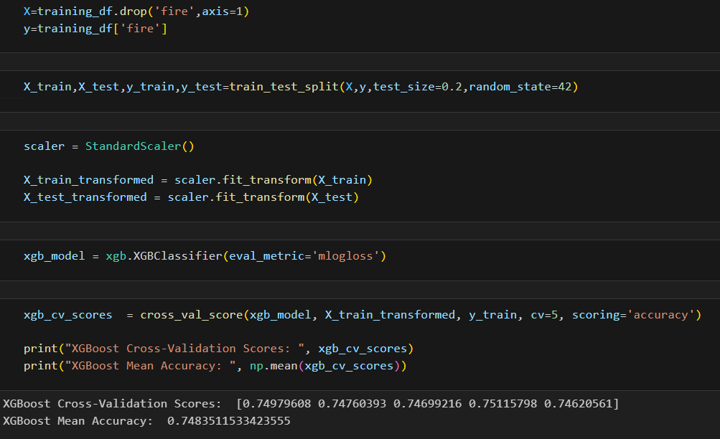
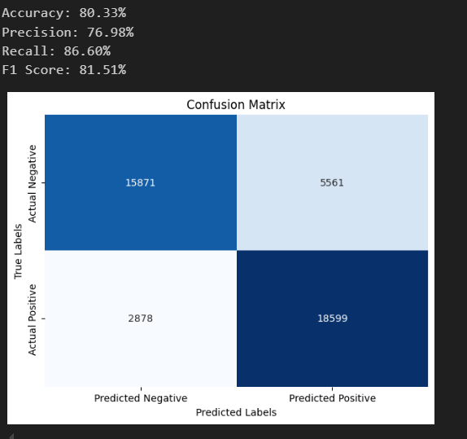
Model Building: XGBoost

Slide 17
OUR PROCESS
Week 3-6
Week 9 - 10
Week 1-2
Week 7-8
Data collection and integration
Evaluation and testing of models using historical data
Feature engineering, and Model Building
Integration of real-time data for continuous monitoring and risk prediction

